Slide 1
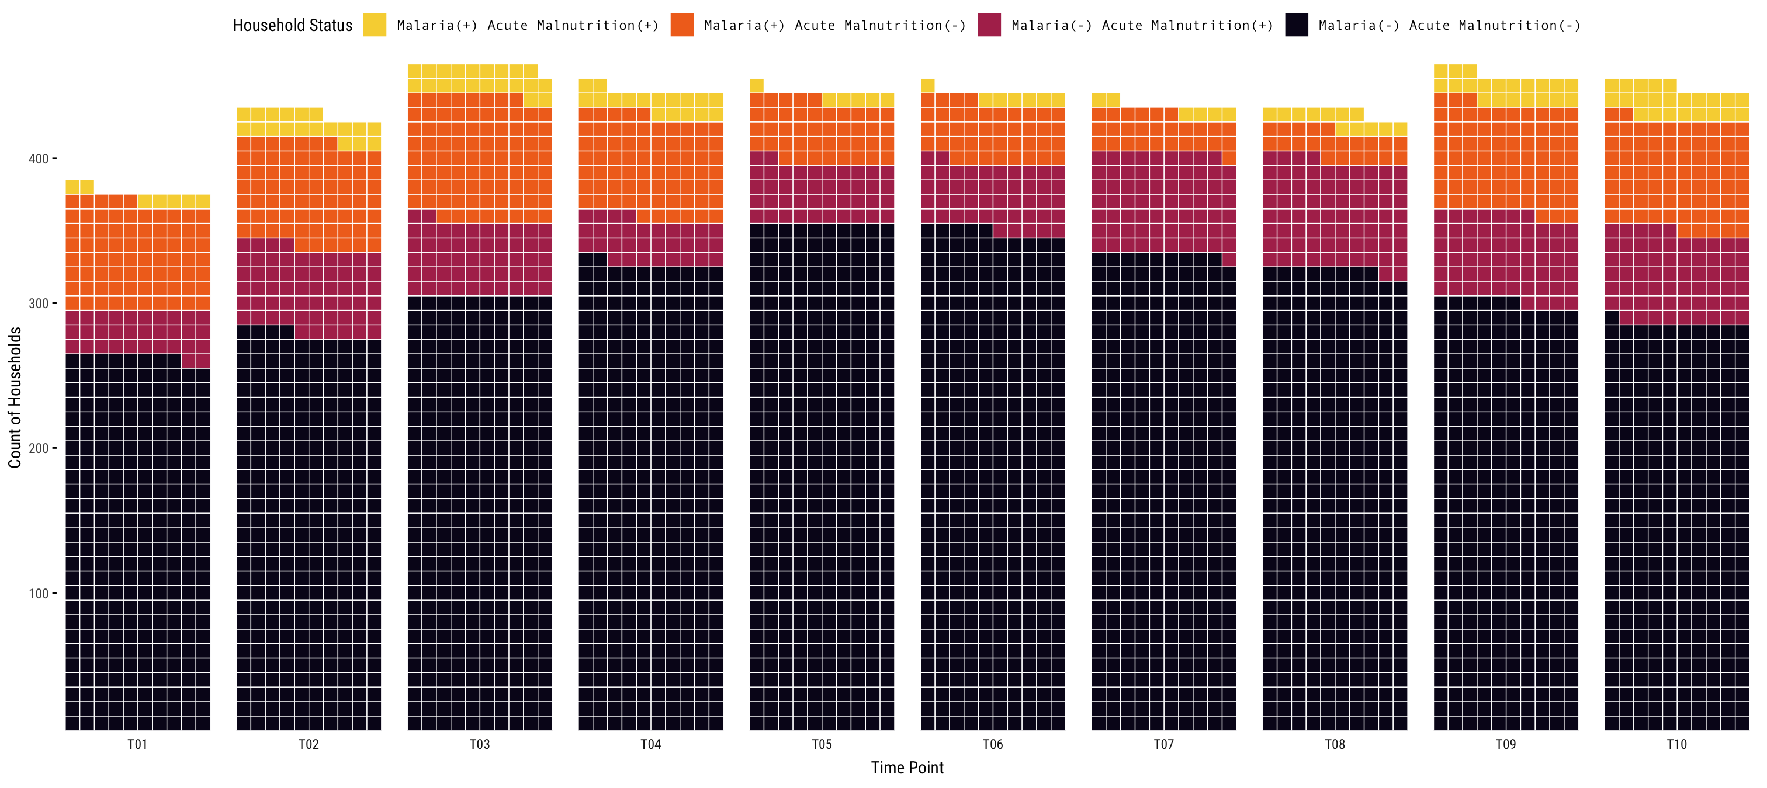
Malaria infection and/or acute malnutrition
No malaria infection
or acute malnutrition
2021-11 to 2021-12
2022-01 to 2022-03
2022-03 to 2022-05
2022-05 to 2022-06
2022-07 to 2022-08
2022-08 to 2022-09
2022-10 to 2022-11
2022-11 to 2022-12
2023-01 to 2023-03
2023-03 to 2023-04

Slide 2
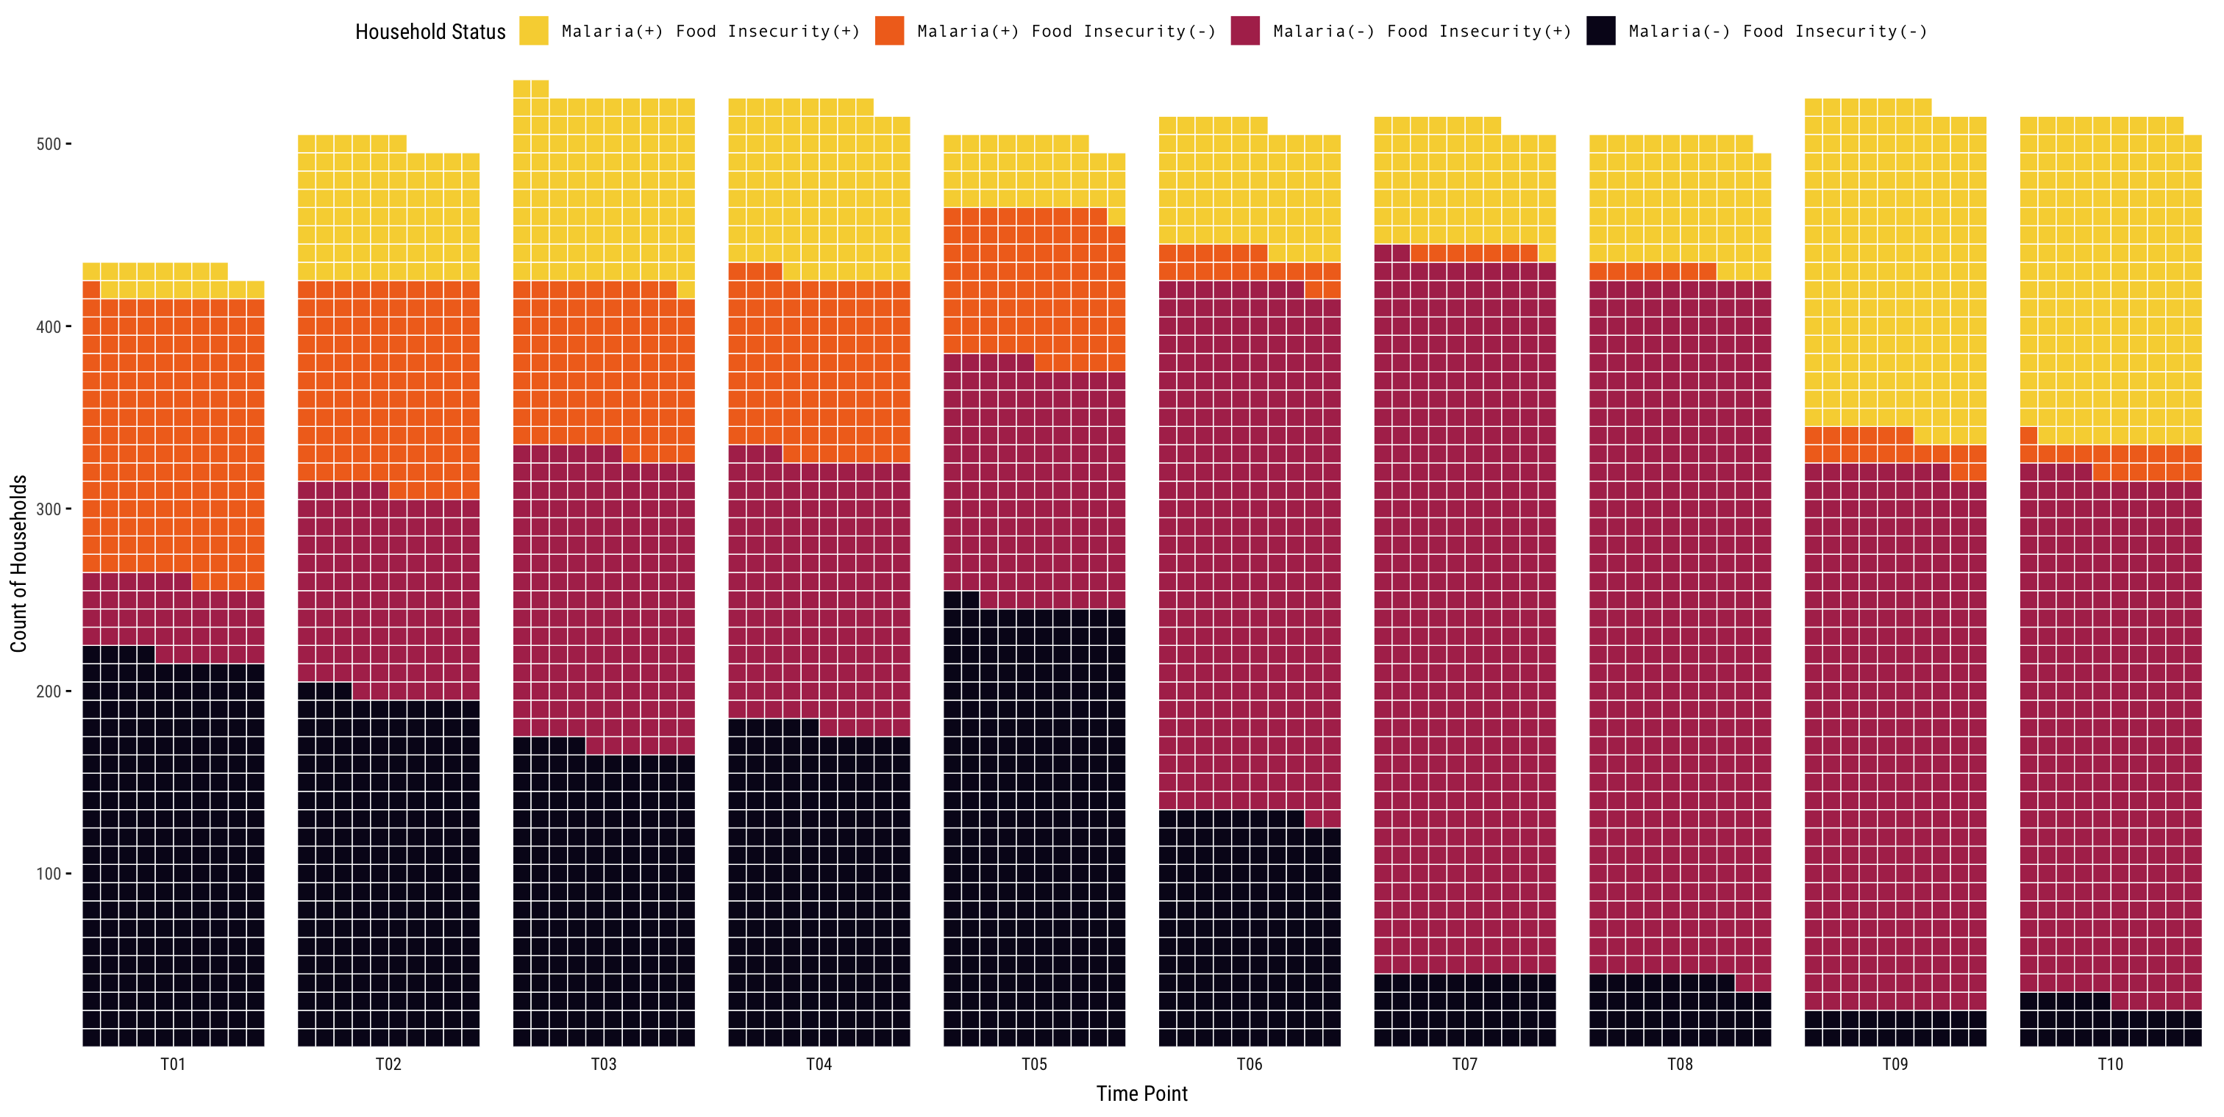
Malaria infection
and/or acute malnutrition
No malaria infection
or acute malnutrition
2021-11 to 2021-12
2022-01 to 2022-03
2022-03 to 2022-05
2022-05 to 2022-06
2022-07 to 2022-08
2022-08 to 2022-09
2022-10 to 2022-11
2022-11 to 2022-12
2023-01 to 2023-03
2023-03 to 2023-04

